Slide 1
Lab 1A - Sequence Generator

Slide 2
Sequence generator
A sequence generator is a sequential circuit which generates a prescribed sequence at its output in synchronization through a CLK.
The length of the series may be indefinite otherwise fixed.
A sequence generator can be used as a code generator, counters, random bit generators, sequence, and prescribed period generator.
A simple sequence generator can be designed by MUX and Flip Flops (FFs).
MUX is a combinational logic circuit designed to combine several input signals and sent them to a single out by selecting lines.
A FF is an electronic component consisting of two stable states and is used to store state information.

Slide 3
Implementation LAB 1A
Deliverables:
Sequence generator:
Design and implement a sequence generator to generate a sequence which has a 10 or more different states: 0, 11, 14, 5, 4, 15, 12, 9, 2,13, 0, 11, ...
Ensure that all invalid stages of the machine clear it (set it too state zero.)
Make sure you have 0 and 15 in your sequence.

Slide 4




Sequence generator
PS | D MSB | C | B | A LSB | NS | D+ | C+ | B+ | A+
0 | 0 | 0 | 0 | 0 | 11 | 1 | 0 | 1 | 1
1 | 0 | 0 | 0 | 1 |  | 0 | 0 | 0 | 0
2 | 0 | 0 | 1 | 0 | 13 | 1 | 1 | 0 | 1
3 | 0 | 0 | 1 | 1 |  | 0 | 0 | 0 | 0
4 | 0 | 1 | 0 | 0 | 15 | 1 | 1 | 1 | 1
5 | 0 | 1 | 0 | 1 | 4 | 0 | 1 | 0 | 0
6 | 0 | 1 | 1 | 0 |  | 0 | 0 | 0 | 0
7 | 0 | 1 | 1 | 1 |  | 0 | 0 | 0 | 0
8 | 1 | 0 | 0 | 0 |  | 0 | 0 | 0 | 0
9 | 1 | 0 | 0 | 1 | 2 | 0 | 0 | 1 | 0
10 | 1 | 0 | 1 | 0 |  | 0 | 0 | 0 | 0
11 | 1 | 0 | 1 | 1 | 14 | 1 | 1 | 1 | 0
12 | 1 | 1 | 0 | 0 | 9 | 1 | 0 | 0 | 1
13 | 1 | 1 | 0 | 1 | 0 | 0 | 0 | 0 | 0
14 | 1 | 1 | 1 | 0 | 5 | 0 | 1 | 0 | 1
15 | 1 | 1 | 1 | 1 | 12 | 1 | 1 | 0 | 0
The sequence : 0, 11, 14, 5, 4, 15, 12, 9, 2,13,
0, 11, ...
0000
1011
1110
1101
$$S_{0}$$
$$S_{1}$$
$$S_{2}$$
$$S_{9}$$
Design using D flip-flop and MUX.

Slide 5














MUX Design
PS | D MSB | C | B | A LSB | NS | D+ | C+ | B+ | A+
0 | 0 | 0 | 0 | 0 | 11 | 1 | 0 | 1 | 1
1 | 0 | 0 | 0 | 1 |  | 0 | 0 | 0 | 0
2 | 0 | 0 | 1 | 0 | 13 | 1 | 1 | 0 | 1
3 | 0 | 0 | 1 | 1 |  | 0 | 0 | 0 | 0
4 | 0 | 1 | 0 | 0 | 15 | 1 | 1 | 1 | 1
5 | 0 | 1 | 0 | 1 | 4 | 0 | 1 | 0 | 0
6 | 0 | 1 | 1 | 0 |  | 0 | 0 | 0 | 0
7 | 0 | 1 | 1 | 1 |  | 0 | 0 | 0 | 0
8 | 1 | 0 | 0 | 0 |  | 0 | 0 | 0 | 0
9 | 1 | 0 | 0 | 1 | 2 | 0 | 0 | 1 | 0
10 | 1 | 0 | 1 | 0 |  | 0 | 0 | 0 | 0
11 | 1 | 0 | 1 | 1 | 14 | 1 | 1 | 1 | 0
12 | 1 | 1 | 0 | 0 | 9 | 1 | 0 | 0 | 1
13 | 1 | 1 | 0 | 1 | 0 | 0 | 0 | 0 | 0
14 | 1 | 1 | 1 | 0 | 5 | 0 | 1 | 0 | 1
15 | 1 | 1 | 1 | 1 | 12 | 1 | 1 | 0 | 0
4 D- Flip Flops
Use Mux to derive the input of each flip flops.
Use CBA as the select for MUX
CBA
D
D0 D1 D2 D3 D4 D5 D6 D7
000 001 010 011 100 101 110 111
0
1
1
0
0
0
1
0
0
0
1 0 0 0
1 0 1 0
$$A^{+}=\overline{D} 0 \overline{D} 0 1 0 D 0$$
$$\overline{D}$$
8:1
8:1
$0$
$$\overline{D}$$
$$A^{+}$$
$0$
$$A^{+}$$
$1$
$0$
$$D$$
$$C B A$$
$0$
$$C B A$$
$$C$$
$$C$$
$$B$$
$$B$$
$$A$$
$$A$$
3 selected lines
2³ Inputs

Slide 6





Circuit Diagram
CBA
D
000 001 010 011 100 101 110 111
0
1
1
0
0
0
1
0
0
0
1 0 0 0
1 0 1 0
$$A^{+}=\overline{D} 0 \overline{D} 0 1 0 D 0$$
$$\overline{D}$$
8:1
$0$
$$\overline{D}$$
$$A^{+}$$
A-FF
LSB
$$A$$
$0$
$1$
$0$
$$D$$
$0$
$$C B A$$
B-FF
$$B$$
$$C$$
$$B$$
$$A$$
C-FF
$$C$$
D-FF
MSB
$$D$$

Slide 7
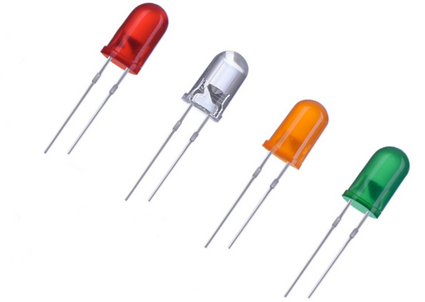








$$\overline{D}$$
8:1
$0$
$$\overline{D}$$
$$Y$$
A-FF
LSB
$$QA$$
+
-
$0$
$1$
GND
$0$
$$D$$
R
$0$
$$C B A$$
R
R
8:1
B-FF
$$QB$$
$$C$$
$$B$$
$$A$$
R
$$B^{+}$$
$$C B A$$
8:1
C-FF
$$QC$$
$$C^{+}$$
$$C$$
$$B$$
$$A$$
$$C B A$$
D-FF
MSB
$$QD$$
8:1
$$C$$
$$B$$
$$A$$
$$D^{+}$$
$$C B A$$
$$C$$
$$B$$
$$A$$

Slide 8
Circuit Implementation
You need
4 FFs – 2 x 7474 (Each 7474 has two FFs)
A-FF, B-FF, C-FF and D-FF
4 Muxs – 4 x 74151
Mux A, Mux B , Mux C, Mux D

Slide 9
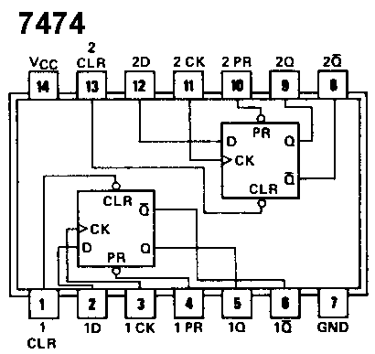
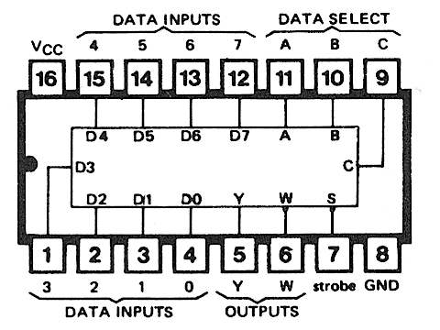
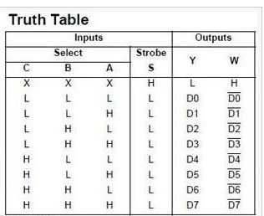
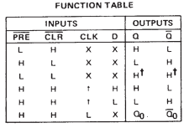
ICs
7474 Dual Positive Edge Triggered D-FF
Vcc to PR and CLR Pin
74151 8:1 Mux.
Gnd to Strobe Pin
74151

Slide 10
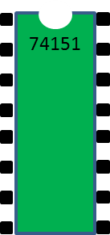
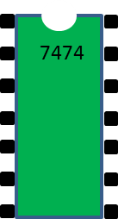
Circuit Implementation Tutorial
D3 VCC
S B
1CLR VCC
1CLR VCC
7474
1D 2CLR
74151
D2 D4
1D 2CLR
D1 D5
1CK 2D
1CK 2D
7474
7474
D0 D6
1PR 2CK
1PR 2CK
Y D7
1Q 2PR
1Q 2PR
W A
1Q‘ 2Q
1Q‘ 2Q
S B
Vcc 2Q’
Vcc 2Q’
GND C

Slide 11
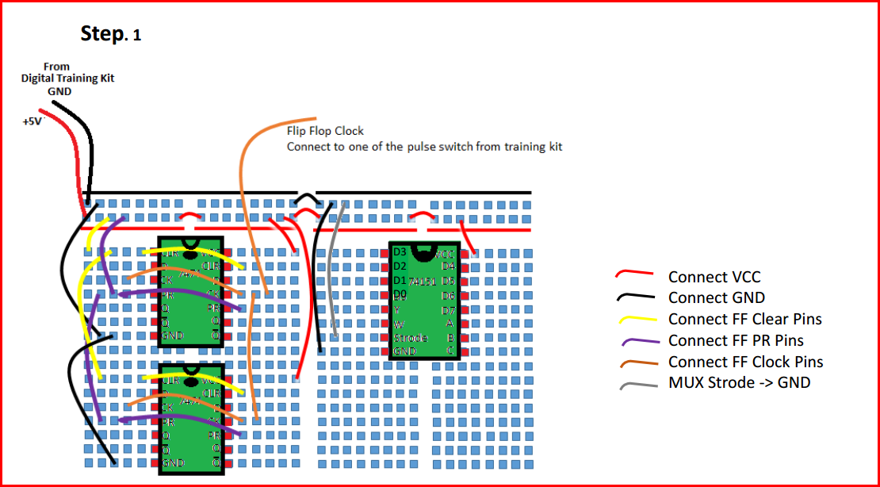
Circuit Implementation Tutorial
7474:
CLR: Active High
PRE: Active High
Connect them to VCC
74151:
Strode: Active Low
Connect it to GND

Slide 12
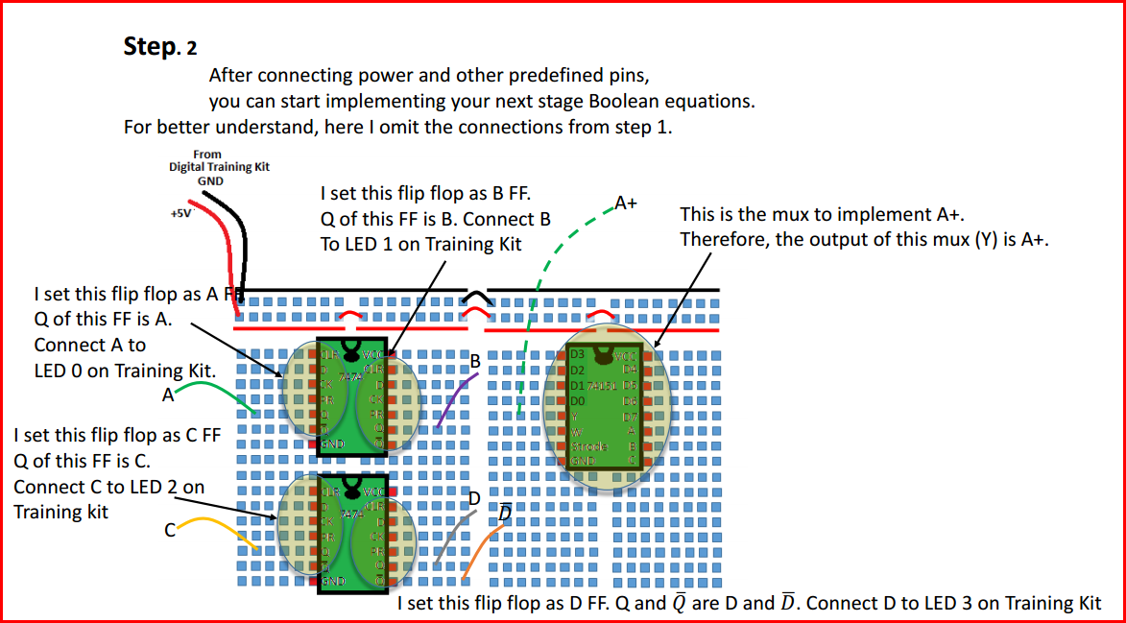
Circuit Implementation Tutorial

Slide 13
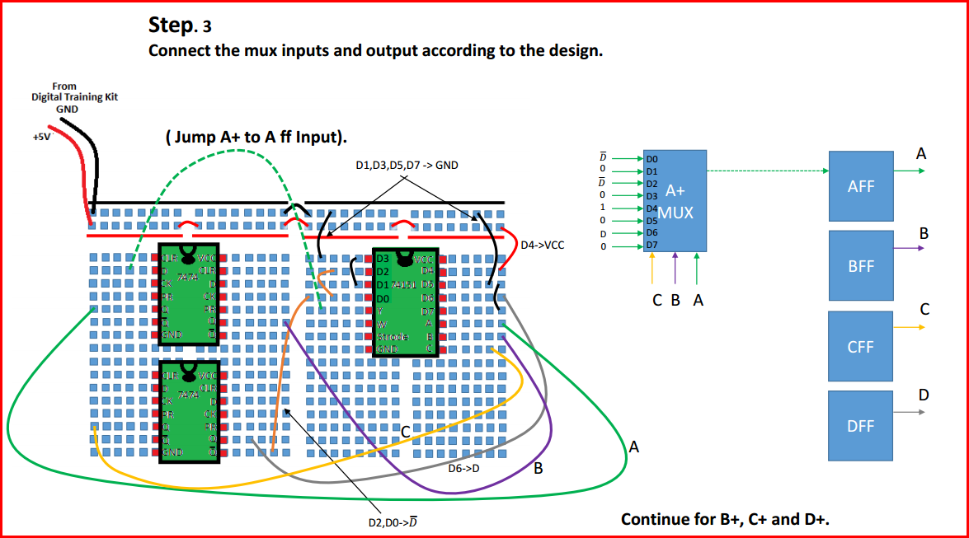
Circuit Implementation Tutorial

Slide 14
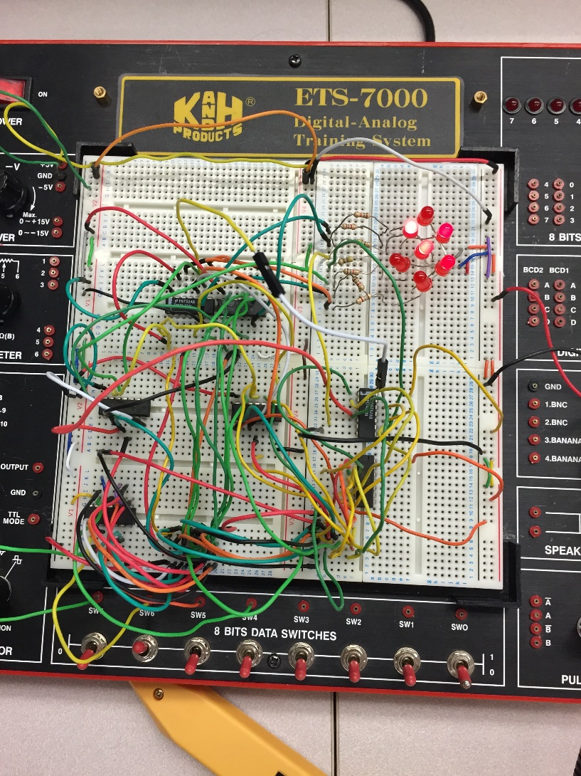
Terrible Circuit
Impossible to follow any of the connections
No color coding
Thick wads of wire
Takes forever to debug (this is my circuit from this class)

Slide 15
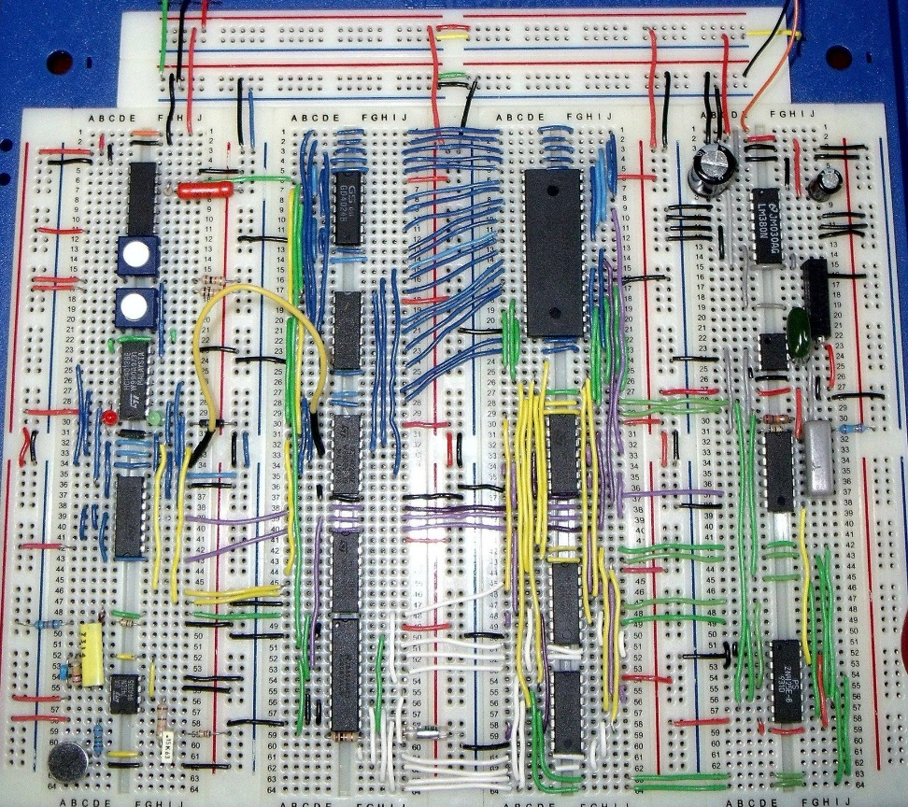
Great Circuit
Minimally length wires
Minimal crossover wires makes it easier to follow connections
Color coded different regions
No crossovers above an IC, makes it possible to remove broken ones

Slide 16
Extra Credit
Modify your sequence detector circuit such that any state, your circuit can go to 0. (10 points)

Slide 17
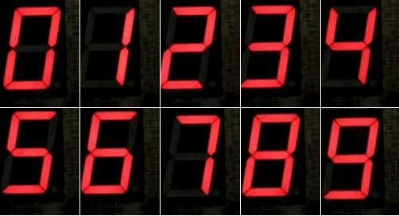

7 Segment Display
Two 7 segment displays on Training Board.
Each has built-in BCD Conversion Circuit.(A is LSB and D is MSB).
 | D | C | B | A | a | b | c | d | e | f | g
0 | 0 | 0 | 0 | 0 | 1 | 1 | 1 | 1 | 1 | 1 | 0
1 | 0 | 0 | 0 | 1 | 0 | 1 | 1 | 0 | 0 | 0 | 0
2 | 0 | 0 | 1 | 0 | 1 | 1 | 0 | 1 | 1 | 0 | 1
3 | 0 | 0 | 1 | 1 | 1 | 1 | 1 | 1 | 0 | 0 | 1
4 | 0 | 1 | 0 | 0 | 0 | 1 | 1 | 0 | 0 | 1 | 1
5 | 0 | 1 | 0 | 1 | 1 | 0 | 1 | 1 | 0 | 1 | 1
6 | 0 | 1 | 1 | 0 | 0 | 0 | 1 | 1 | 1 | 1 | 1
7 | 0 | 1 | 1 | 1 | 1 | 1 | 1 | 0 | 0 | 0 | 0
8 | 1 | 0 | 0 | 0 | 1 | 1 | 1 | 1 | 1 | 1 | 1
9 | 1 | 0 | 0 | 1 | 1 | 1 | 1 | 0 | 0 | 1 | 1

Slide 18
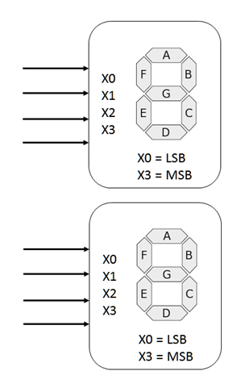

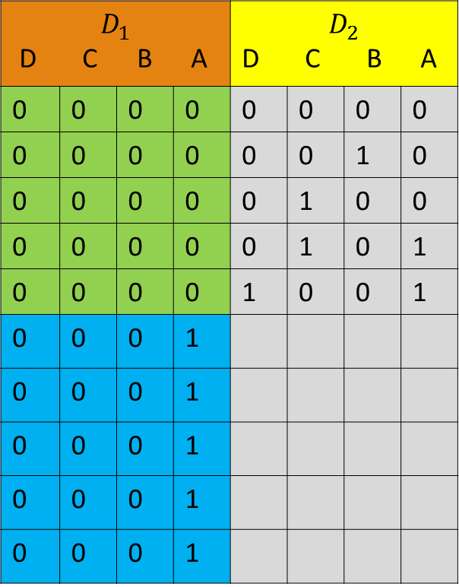

Display the Sequence
PS | D MSB | C | B | A LSB
0 | 0 | 0 | 0 | 0
2 | 0 | 0 | 1 | 0
4 | 0 | 1 | 0 | 0
5 | 0 | 1 | 0 | 1
9 | 1 | 0 | 0 | 1
11 | 1 | 0 | 1 | 1
12 | 1 | 1 | 0 | 0
13 | 1 | 1 | 0 | 1
14 | 1 | 1 | 1 | 0
15 | 1 | 1 | 1 | 1
$$D_{1}$$ D C B A |  |  |  | $$D_{2}$$ D C B A
0 | 0 | 0 | 0 | 0 | 0 | 0 | 0
0 | 0 | 0 | 0 | 0 | 0 | 1 | 0
0 | 0 | 0 | 0 | 0 | 1 | 0 | 0
0 | 0 | 0 | 0 | 0 | 1 | 0 | 1
0 | 0 | 0 | 0 | 1 | 0 | 0 | 1
0 | 0 | 0 | 1
0 | 0 | 0 | 1
0 | 0 | 0 | 1
0 | 0 | 0 | 1
0 | 0 | 0 | 1
$$D_{1}$$
A
B
C
D
$$D_{2}$$
A
B
C
D

Slide 19











$$\overline{D}$$
8:1
$0$
$$D$$
$$Y$$
A-FF
LSB
$$A$$
$$D_{1}$$
$0$
Combination Logic For Display
$1$
A
B
C
D
$0$
$$D$$
$0$
$$C B A$$
B-FF
$$B$$
$$C$$
$$B$$
$$A$$
$$D_{2}$$
$$C$$
A
B
C
D
C-FF
D-FF
MSB
$$D$$
Display Circuit
Sequence Generator

